Slide 1
BIKE DEKHO-BIKE SALES ANALYSIS Internship Project-1
PRESENTED TO : LABMENTX
NAME : PRAJNA C
Date : 23-11-2025

Slide 2
Introduction
Objective: Analyse bike sales data to extract actionable business insights.
Dataset: Bike Dekho dataset containing customer demographics and purchase behaviour.
Importance: Understanding buyer profiles and regional trends helps target marketing and sales strategies effectively.
Dataset Overview
Dataset contains 1028 records and 13 attributes.
Key attributes: Customer ID, Gender, Income, Education, Marital Status, Home Ownership, Purchased Bike, Region, Age, Children, Occupation, Cars, Commute distance
Data ranges across multiple demographics and geographic regions.

Slide 3
Data Cleaning
Handled missing and inconsistent values.
Converted income values to numeric format.
Created derived columns: Age Bracket (Adolescent, Middle Age, Old), Income Bracket (Low, Medium, High).
Confirm columns are standardized: full words instead of codes (“Married” / “Single” instead of “M/S”, “Male/Female” instead of “M/F”).
Removed duplicates and validated data consistency.

Slide 4
Exploratory Data Analysis (EDA) Setup
Created pivot tables to analyze sales distribution: by Gender, Age, Region, Occupation, Education, Marital Status.
Calculated key performance indicators (KPIs): total buyers, average income, percentage of buyers by gender and home ownership.
Applied formulas for enhanced insights.
Key Findings from EDA
Formulas are used to calculate the summary statistics without pivot table.
Majority of bike buyers are Male.
Sales concentrated in North America.
Average income of buyers is 57962.58
Homeownership positively correlates with purchasing a bike.

Slide 5
Visualizations in EDA
Bar charts highlighting buyers by Gender and Income.
Pie charts representing Age Bracket distribution among buyers.
Other visuals for Occupation and Education breakdowns.
These charts help in quick understanding of data patterns.

Slide 6
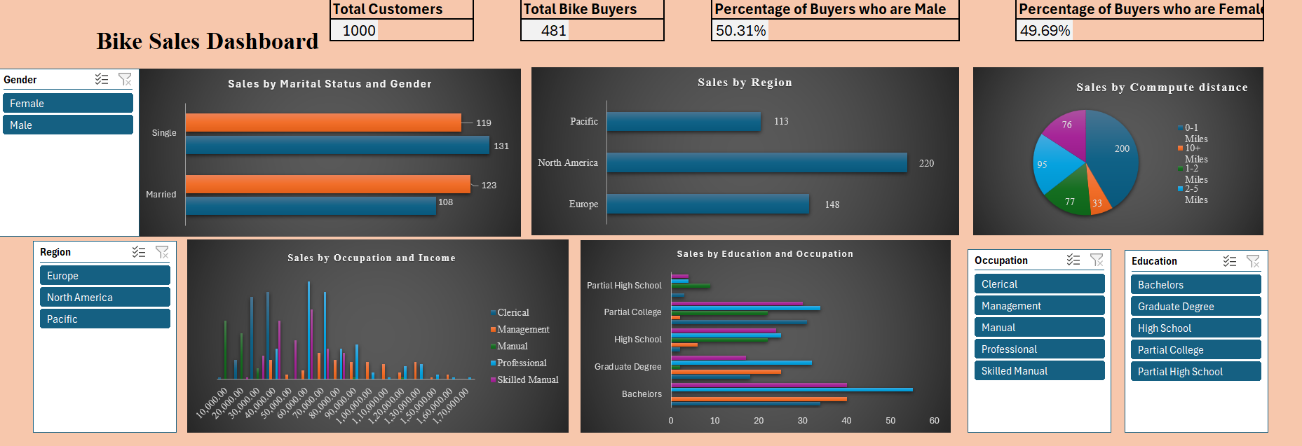
Dashboard Design and Layout
Consolidated key pivot tables and charts into a dashboard sheet.
Dashboard includes interactive features: slicers for Gender, Region, Education and Occupation.

Slide 7
Conclusion
Project successfully delivered end-to-end data cleaning, analysis, and dashboard solution.
Valuable insights extracted to aid marketing and sales.
Dashboard enables efficient data exploration and business decisions

Slide 8
THANK YOU

